Slide 1

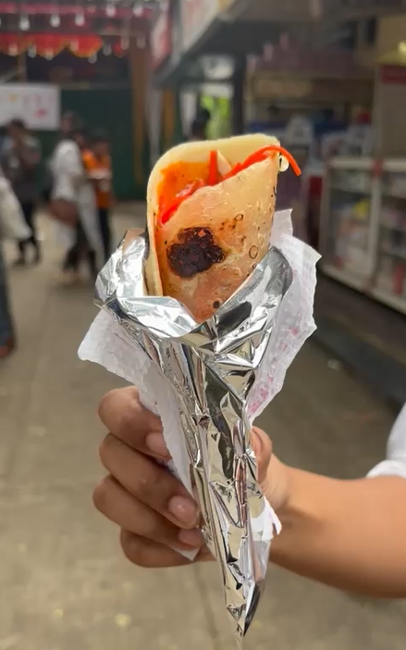
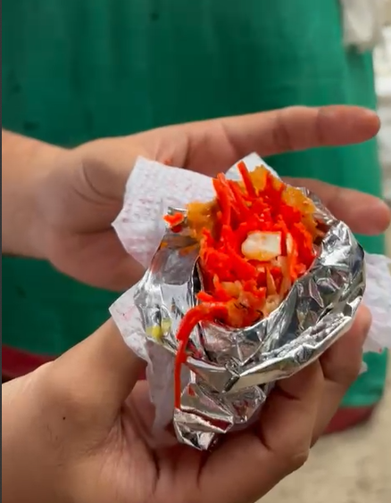

Wasting the Final Bite: The Messy Frankie Eating Problem in Mumbai
Every Mumbaikar knows the struggle. You're savoring your Frankie, that delicious roll of goodness, but the foil wrapper is a constant threat. It's impossible to finish the last bite without a messy struggle. And let's be honest, it's not just the messy foil, but the frustration of leaving behind the final portion of that perfectly packed frankie.
by Frankie Jugaadus

Slide 2
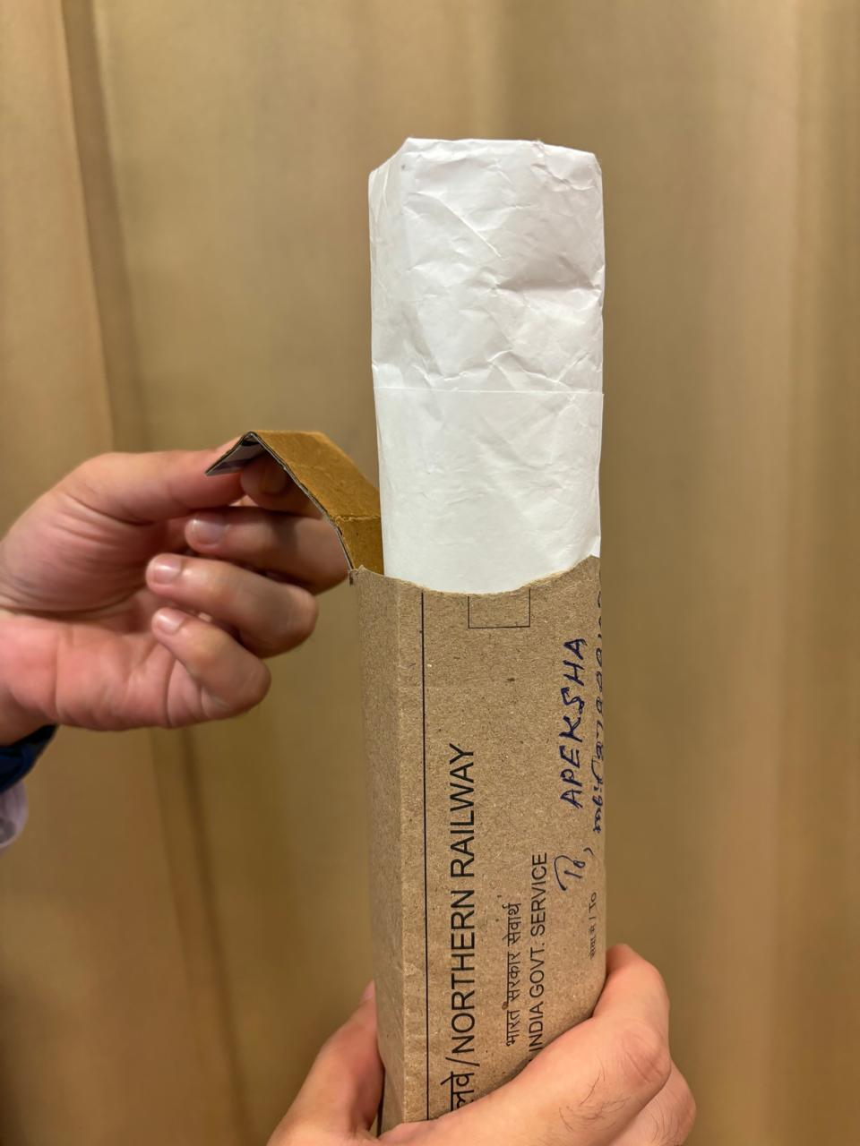



Sliding Sleeve with Collection Pouch: Tidy Eating, No Leftovers
Slide and Enjoy
As you eat, the sleeve slides down, providing easy access to the entire frankie. It's like a custom-made frankie holder.
No More Dropped Fillings
The collection pouch at the bottom captures any fallen ingredients, preventing a messy situation and ensuring that you enjoy every last bit.
Tidy and Sustainable
Say goodbye to messy hands and say hello to a cleaner, more sustainable way to enjoy your Frankie.

Slide 3
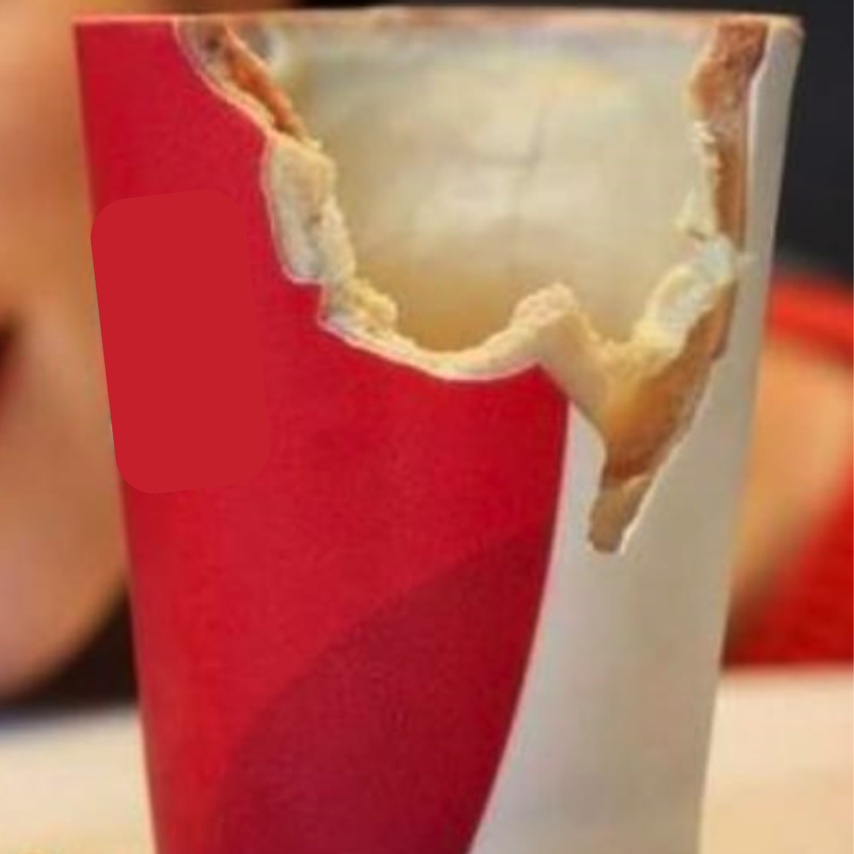
Edible Wrapper: Eliminating Waste and Mess
No More Waste
This edible wrapper would be a game-changer for Frankie lovers. It disappears with the last bite, leaving no trace behind.
Seamless Experience
Imagine, no more struggling with the foil, no messy fingers, just pure frankie enjoyment from the first bite to the last.
Eco-Friendly Choice
This solution is not only practical but also environmentally friendly. It reduces waste and promotes a more sustainable way to enjoy our favorite street food.

Slide 4
Attributes of the Product
Ease of Assembly
Comfort
Attributes
Dynamic Adjustment
Ease of Use
Simplicity
Portability
Ease of Manufacturing

Slide 5


Benefits
No mess or waste, including the final portion of the Frankie Seamless eating experience from start to finish environmentally friendly
Keeps hands clean and tidy throughout the eating process ensures the user can enjoy the entire Frankie without waste Minimizes mess and environmental impact

